Slide 1
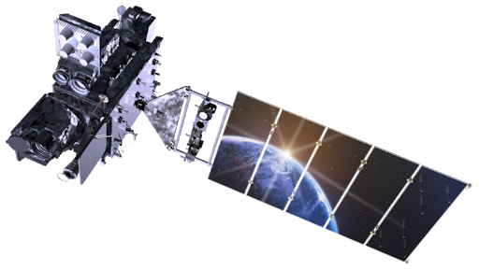
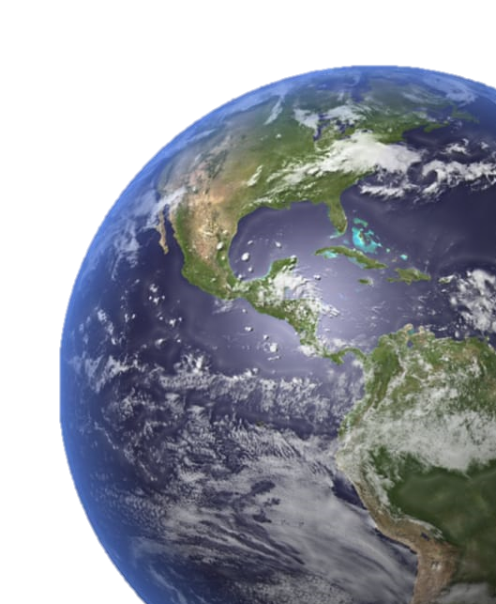
SAR AUTOMATIC TARGET RECOGNITION USING UMBRELLA MODEL
Department of CSE
Jyothi Engineering College
Thrissur
PRESENTED BY: GUIDED BY:
Nair Anjali Valsalan Mr.Aneesh Chandran
JEC17CS072 Asst.Professor
S7 CSEB CSE, Dept.
13/11/20
CSE,department

Slide 2
CONTENTS
1.Mission & Vision of Department
2.Abstract
3.Introduction
4.Methodology
5.Applications
6.Conclusion
7.Reference
13/11/20
CSE,department
2

Slide 3
Vision of the Department
Creating eminent and ethical leaders in the domain of Computational Sciences through quality professional education with a focus on holistic learning and excellence.
Mission of the Department
To create technically competent and ethically conscious graduates in the field of Computer Science and Engineering by encouraging holistic learning and excellence.
To prepare students for careers in Industry, Academia and the Government.
To instill Entrepreneurial Orientation and research motivation among the students of the department.
To emerge as a leader in education in the region by encouraging teaching, learning, industry and societal connect.
13/11/20
CSE,department
3

Slide 4
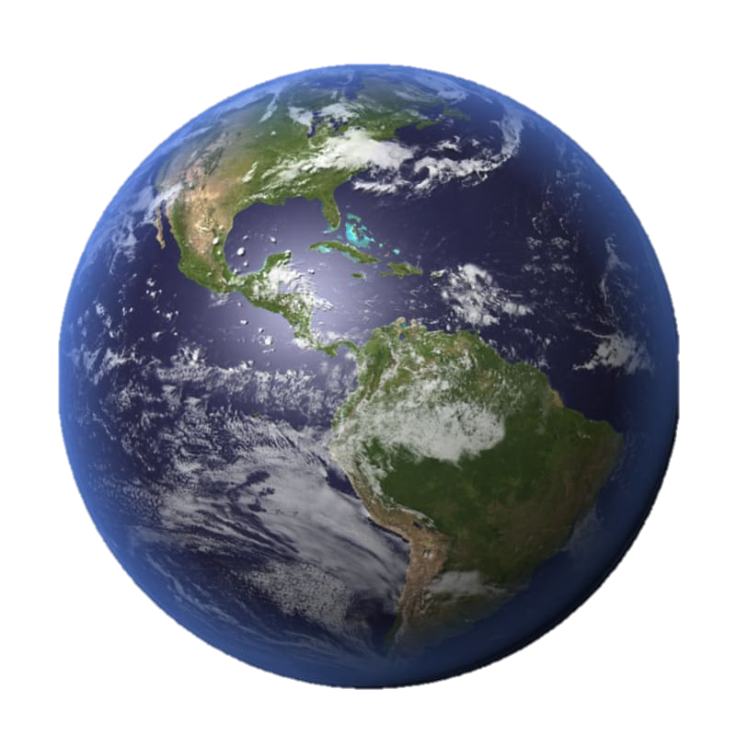
ABSTRACT
Among Many (CNN) architectures in optical image classification available,
only few are used for Synthetic Aperture Radar Automatic Target Recognition
Reason- OVERFITTING
Based on the characteristics of the SAR image,
Here a novel deep convolutional neural network architecture named Umbrella is discussed.
We will be trying to classify 10 military vehicles and & 8 variants of one among them.
13/11/20
CSE,department
4

Slide 5
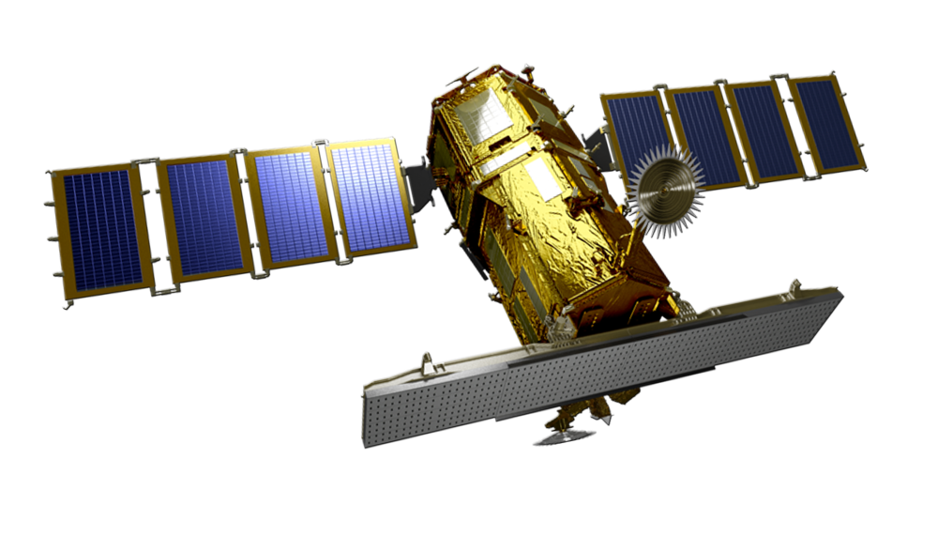
INTRODUCTION
RADAR
Radio Detection and Distance Ranging
Coined by Scottish scientist Robert Watson-Watt 1935
An electromagnetic system to detect –
presence, location, distance, velocity of an object from radar
like- Aircrafts, ships, military vehicles, etc.
Active sensor Radiates (energy)signals into space and record echo of reflected
signal
5. operate at radio frequencies (RF) between 300 MHz and 15 GHz.
6. Synthetic Aperture Radar- used to create 2D or 3D reconstructions of objects,
such as landscapes.
7. Examples of radar satellite-Kompsat-5
13/11/20
CSE,department
5

Slide 6
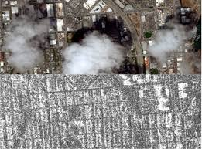
INTRODUCTION
SAR IMAGES
1. Optical images-Rich with colors
SAR images- Grayscale
2. High resolution images in all weather ,
day& night
3. Pixel value- 2 reflections of EMW
4. first -single reflection from the surface of the target
depends on the surface roughness, shape & material
5. secondary reflection of EMW from dihedral corner
between the target & ground, directly proportional height
of the radar and the shooting angle.
6. Bright areas- high backscatter
7. Darker areas –low backscatter
8. SAR has the characteristics of scattering electromagnetic, high resolution, speckle noise, huge size, and single channel
13/11/20
CSE,department
6

Slide 7
INTRODUCTION
GENRIC ISSUES FACED:
Due to the limited data set of SAR images, the SAR ATR task using the convolutional neural network easily causes overfitting
1. Transfer Learning-
first pre-train CNN from large data set and then fine-tune the network on
specific task for small SAR dataset
2. lot of unlabeled SAR images may be appropriate to take place of
optical images- requires a lot of manual works.
3. Data Augmentation-
in training dataset target kept in center
in real scenario target at random position
considering translation, speckle noise, and rotation as data augmentation
13/11/20
7

Slide 8
INTRODUCTION
SOLUTION FOR ISSUES FACED:
1.general improvement –increase width & depth
2. Residual network proposed-
deep residual network more than 100 layers, the error was reduced to be 3.57%
depth is not unlimited because too deep network still leads to the problem
of overfitting
3.inception modules-
reduces complexity
joint network architecture proposed adding an inception module into ResNet
achieve better accuracy than the single inception network
13/11/20
7

Slide 9
INTRODUCTION
UMBRELLA MODEL:
Framework consists of two alternate CNN-layer blocks.
Fusion of 6 3-layer path- diverse level features from different convolution layers
Fusion of convolution & pooling layers - reduce dimensions &extract hierarchical feature information
Combo extracts rich features from different spatial scale and simultaneously alleviate overfitting.
umbrella architecture possesses a very robust generalization capability and will be potential for SAR-ATR.
99% accuracy -10-class targets
higher than 96% accuracy -8 variants
13/11/20
7

Slide 10
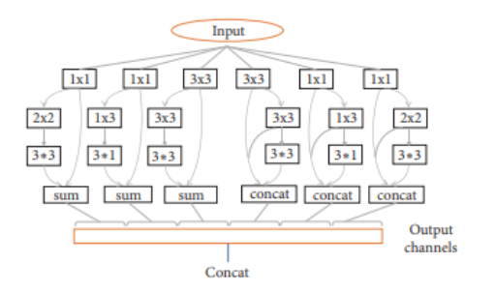
WORKING
13/11/20
FIG 1: Umbrella module of the basic component of the proposed architecture.
17/10/20
7

Slide 11
WORKING
1. FIRST PATH
1x1 Kernel- *reduces amount of computation
preserves all the information of input space
ln the subsequent step 2x2 and 3x3 convolution kernel used
to extract deeper features
2. SECOND PATH
first uses the 1x1 convolution kernel.
1x3 and 3x1 convolution kernel in the subsequent step, to
extract different features -reduce parameters with respect to the
2x2 and 3x3 convolutional kernel.
3. THIRD PATH
Uses conventional convolution kernel with the 3x3 convolution kernel
13/11/20
13

Slide 12
WORKING
1. Avoid increasing calculation overhead, the number of convolution kernels
of each layer is controlled to be lower than 64
2. Network 3 convolutional blocks & 2 umbrella blocks,
3. which contain 12 convolutional layers, 2 fully connected layers,
and 3 pooling layers.
4. Architecture contains a total 1344 convolution kernels & 131 full connected
layer neurons
5. Only one dropout layer is used in the network in order to reduce overfitting.
13/11/20
CSE,department
11

Slide 13
METHODOLOGY
DATA ACQUISITION
EXPIREMENTS ON STANDARD DATASET OF 10 CLASS VEHICLES
DATA AUGMENTATION
RESULTS OF MODEL COMPARED WITH ALGO OF OPTICAL IMAGE CLASSIFICATION
UMBRELLA METHOD USED TO CLASSIFY 8 VARIANTS
13/11/20
12

Slide 14
WORKING
DATA ACQUISITION
MSTAR (Moving and Stationary Target Acquisition and Recognition) program
DARPA & AFRL
About Sensor-
high-resolution (0.3m x 0.3m)spotlight synthetic aperture radar
operating in the x-band & polarization mode of HH polarization
4. Data set contains-
Ground vehicles- 10 Types like:
BTR70, BMP2,T72 , 2S1 , BRDM2, BTR60, D7, T62 , ZIL131, ZSU234.
8 variants of T72 tank with different military-configurations,
for example machine guns, fuel tanks, and the antennas
13/11/20
13

Slide 15
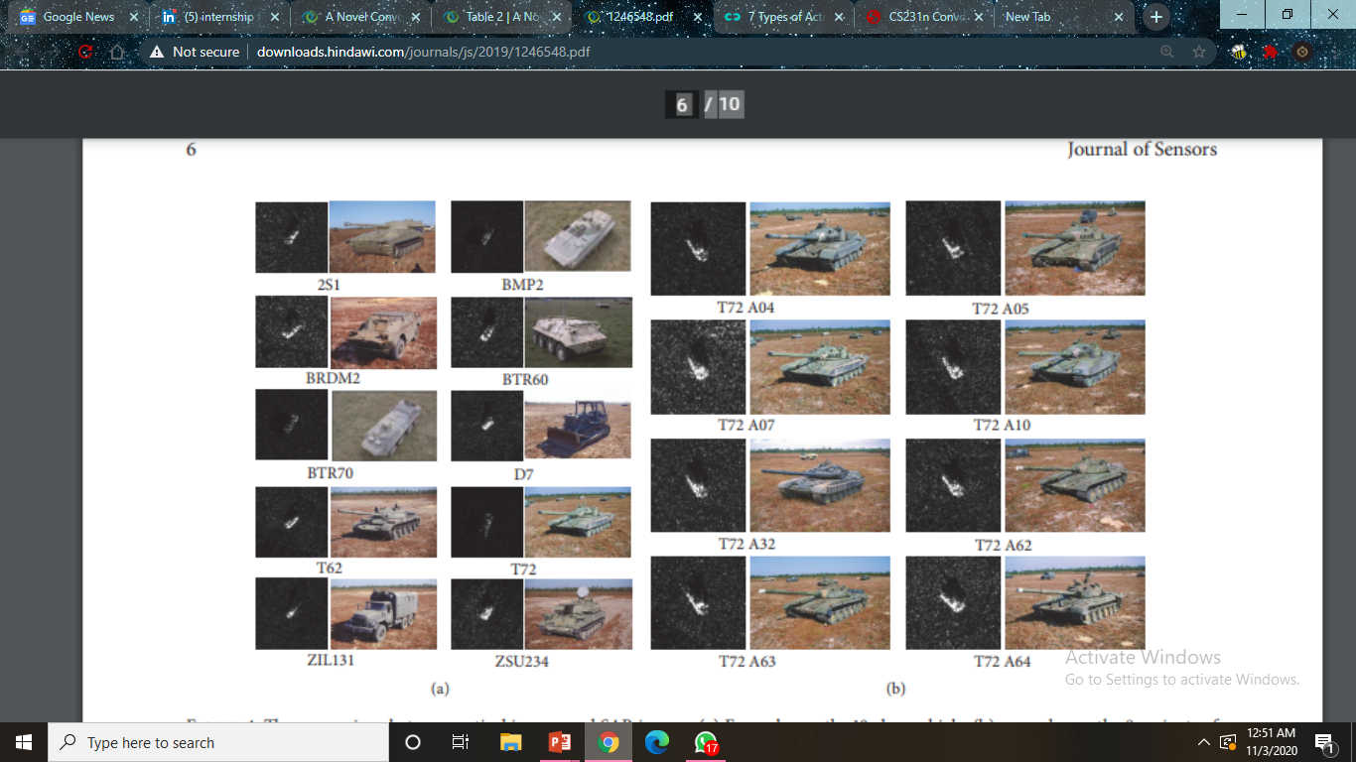
METHODOLOGY
Optical & SAR Images
FIG 2: (a) 10 VEHICLES (b) 8 VARIANTS OF T72 TANK
13/11/20
13

Slide 16
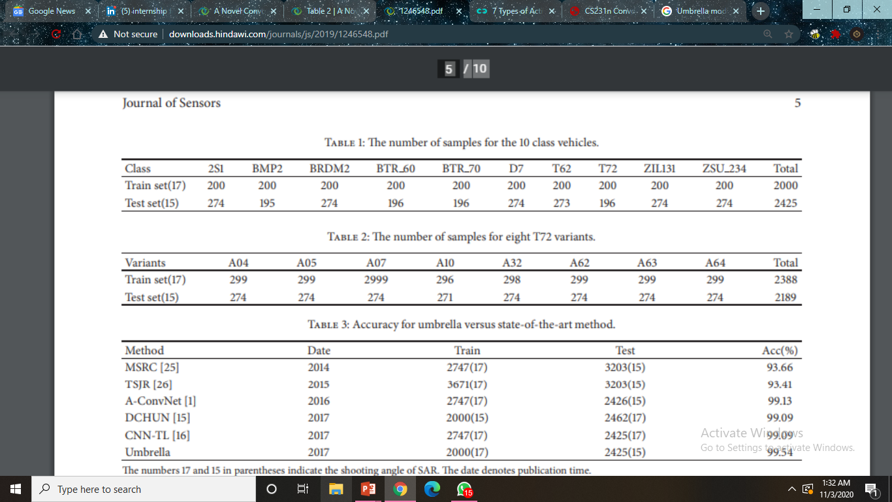
METHODOLOGY
EXPIREMENTS ON STANDARD DATASET OF 10 CLASS VEHICLES
1.Training dataset- 2000 samples
2.Testing dataset- 2425 samples
3. Difference -shooting angle =17∘ for the train set & 15∘ for the test set
4. One complete target in 1 image
Fig3:
13/11/20
14

Slide 17
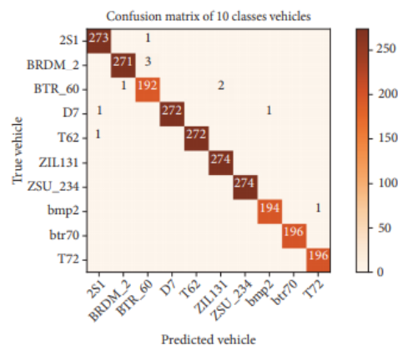
METHODOLOGY
CONFUSION MATRIX ACCURACY & RELIABILITY
Fig 5:
Fig 4:
13/11/20
15

Slide 18
METHODOLOGY
CONFUSION MATRIX ACCURACY & RELIABILITY
1. *Abscissa- predicted label
*Ordinate - real label.
2.Digit in diagonal grid -number of prediction matching real labels.
3.Other digits - number of targets misclassified.
4. In fig5:accuracy for the classification can achieve 99.54% for the test set,
derived from umbrella method
4.From fig4: its clear Samples misclassified max value is 3- ensures accuracy
5. Furthermore, BMP2, BTR70 & T72 with low pixel values also show almost 100% accuracy, further confirming the reliability of our method.
13/11/20
16

Slide 19
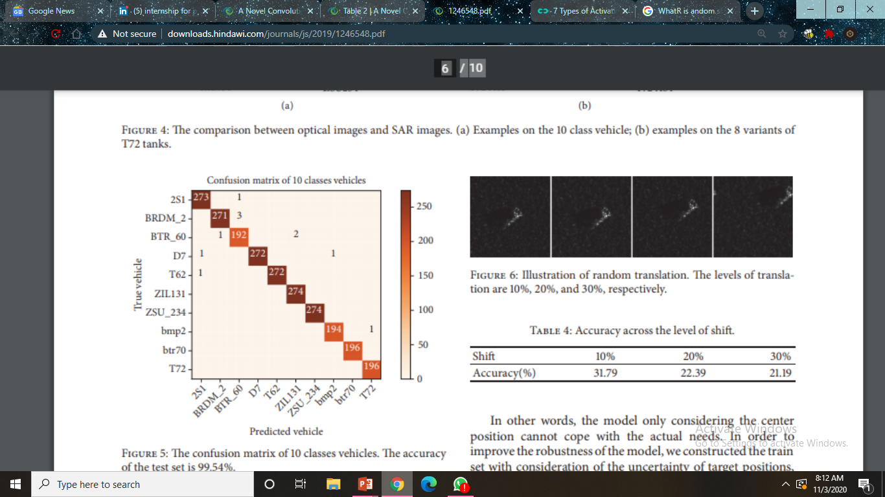
METHODOLOGY
Experiments on Augmentation Data for the Ten Classes of Vehicles
Previous result -targets of the image set are fixed in the middle position
Real scenario target at random position
Translation- image shifted by different levels 10%, 20%, and 30%
13/11/20
17

Slide 20
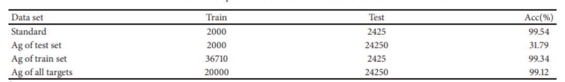
METHODOLOGY
Model 1 : train set- standard ; test set –translated image by 10%, 20%, and 30% -> low accuracy
larger the translation-extent, the lower the accurate rate.
2. To improve the robustness of the model:
Model 2: number of the targets at the original image was extended by
10 times through the random translation manner
Consequently, train set and the test set data are 10 time larger than previous ones
3. When more practical situations taken, model is undoubtedly more robust
and easier to identify the targets under different scenarios.
13/11/20
18

Slide 21
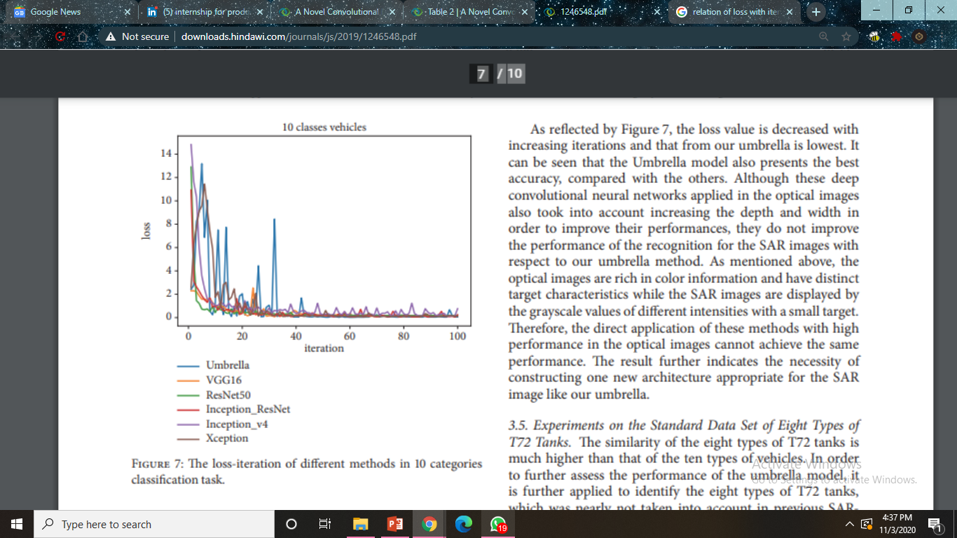
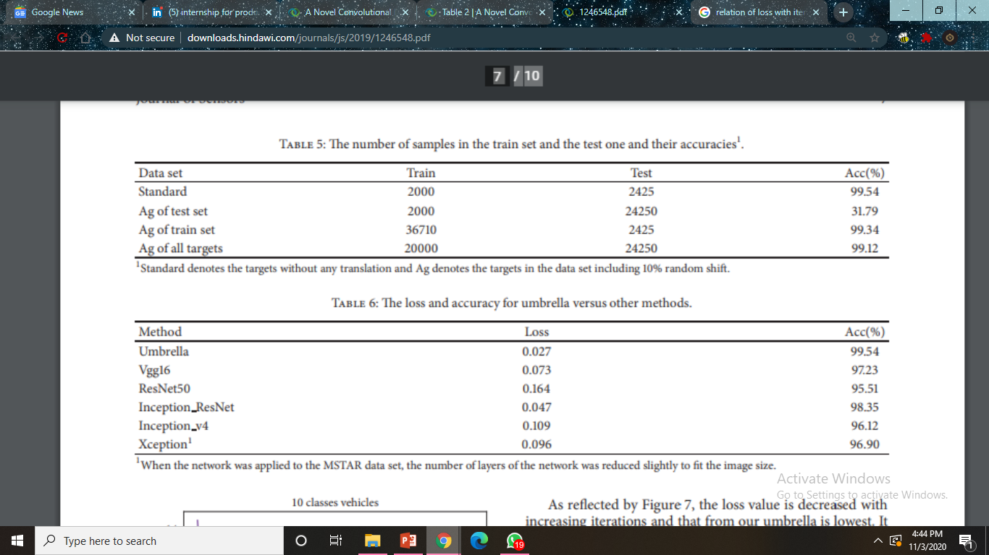
METHODOLOGY
Experiments vs. the State-of-the-Art CNN Architecture
1. loss value decreases with increasing iterations- umbrella is lowest
2.Umbrella model also presents the best accuracy
This proves robustness of system
13/11/20
19

Slide 22
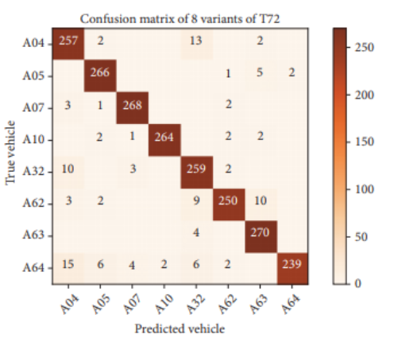
METHODOLOGY
Experiments on the Standard Data Set of Eight Types of T72 Tanks
Similarity of the eight types of T72 tanks is much higher than that of the ten types of vehicles
CONFUSION MATRIX
1. Number of targets matching real labels is large
and only few samples in every classes
were wrongly predicted, not more than 15
2. Umbrella model still achieves 96.35%
13/11/20
20

Slide 23
CONCLUSION
Based on the SAR characteristics, novel CNN architecture named Umbrella is discussed by minimizing depth but extract enough features at different levels so as to achieve rapid and accurate detection of the SAR targets.
Umbrella used to detect ten types of vehicles and eight classes of T72 variants from the MSTAR data set, where we also took in account the diverse position of targets.
umbrella model give more than 99% accuracy for the classification of 10-class targets & higher than 96% accuracy for the 8 variants of the T72 tank.
The performance of the umbrella model is higher than previous methods reported. The results clearly indicate that the architecture proposed here will be potential for SAR-ATR in practice
13/11/20
CSE,department
21

Slide 24
REFERENCE
Remote Sensing Satellite Image Processing Techniques for Image Classification:
A Comprehensive Survey- March 2018
2. A Novel Convolutional Neural Network Architecture for SAR Target Recognition
Research paper Received 10 January 2019; Revised 20 March 2019;
Accepted 24 March 2019; Published 5 May 2019
Evaluation of SAR ATR algorithm performance sensitivity to MSTAR extended
operating conditions - May 2017
4. Modern approaches in deep learning for SAR ATR- September 2018
SAR ATR by a combination of convolutional neural network and support
vector machines - December 2016
https://www.sciencedirect.com/science/article/abs/pii/S0925231216310104
13/11/20
CSE,department
22

Slide 25
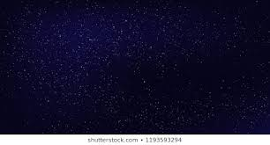
Thank you

